Slide 1
User login / Signup
User Name
Password
Login
Signup

Slide 2
User Signup
User Name
Password
email
User type
Mobile Number
Ok
cancel

Slide 3
Admin Landing Page
Update Profile
Logout
Import data Manage company Manage Exchange Update IPO details

Slide 4
Update User profile
User Name
Password
email
User type
Mobile Number
Ok
cancel

Slide 5
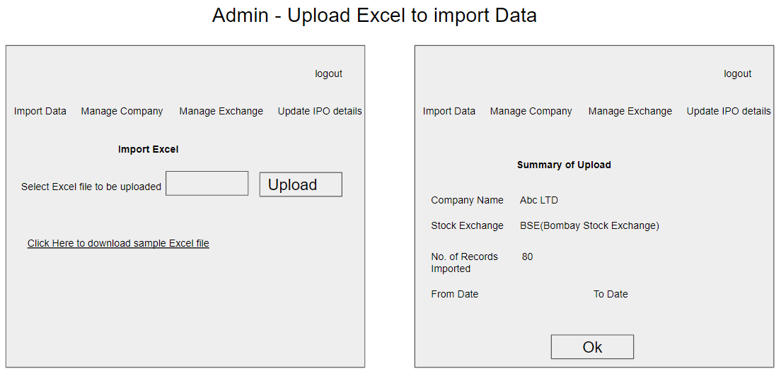

Slide 6
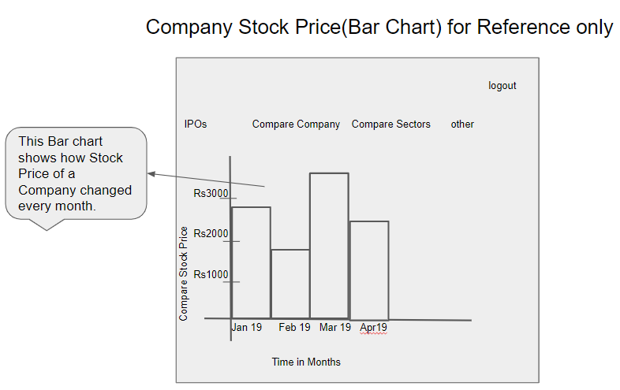

Slide 7
Manage Companies
Logout
Import data Manage company Manage Exchange Update IPO details
List of Companies
Search company
Company Name | BSE,NSE | CEO | Sector | Action
Google inc | 1234 | Firstname | Idd……
Add
Edit
Deactive

Slide 8
Insert New Company
Logout
Import data Manage company Manage Exchange Update IPO details
Insert new company
Company Name
Turn over
CEO
Board of Directors
Brief Description
Listed in Stock Exchanges
Sector
Stock code
Save
cancel

Slide 9
List of IPO details
Logout
Import data Manage company Manage Exchange Update IPO details
List of IPO Details
Company Name | BSE,NSE | CEO | Sector | Action
Google inc | 1234 | Firstname | Idd……
Add
Edit

Slide 10
Add IPO Details
Logout
Import data Manage company Manage Exchange Update IPO details
Add IPO Details
Company Name
Stock exchange
Price per share
Total number of shares
Open Date Time
Remarks
Save
cancel

Slide 11
User Landing Page
Update Profile
Logout
IPOs Compare company Compare Sectors other

Slide 12
Comparison Charts
Logout
IPOs Compare company Compare Sectors other
Select Company/Sector
Company
Select Stock Exchange
BSE
Select Company/Sector
Abc
From Period
To Period
Generate Map

Slide 13
View IPO Details
Open date time
Logout
IPOs Compare company Compare Sectors other
IPO details
Company Name | Stock exchange | Price/share | Total numbers of shares | Open date time
company1 | BSE | Firstname | Idd……
Remark

